Slide 1
Malware
Lecture 6

Slide 2
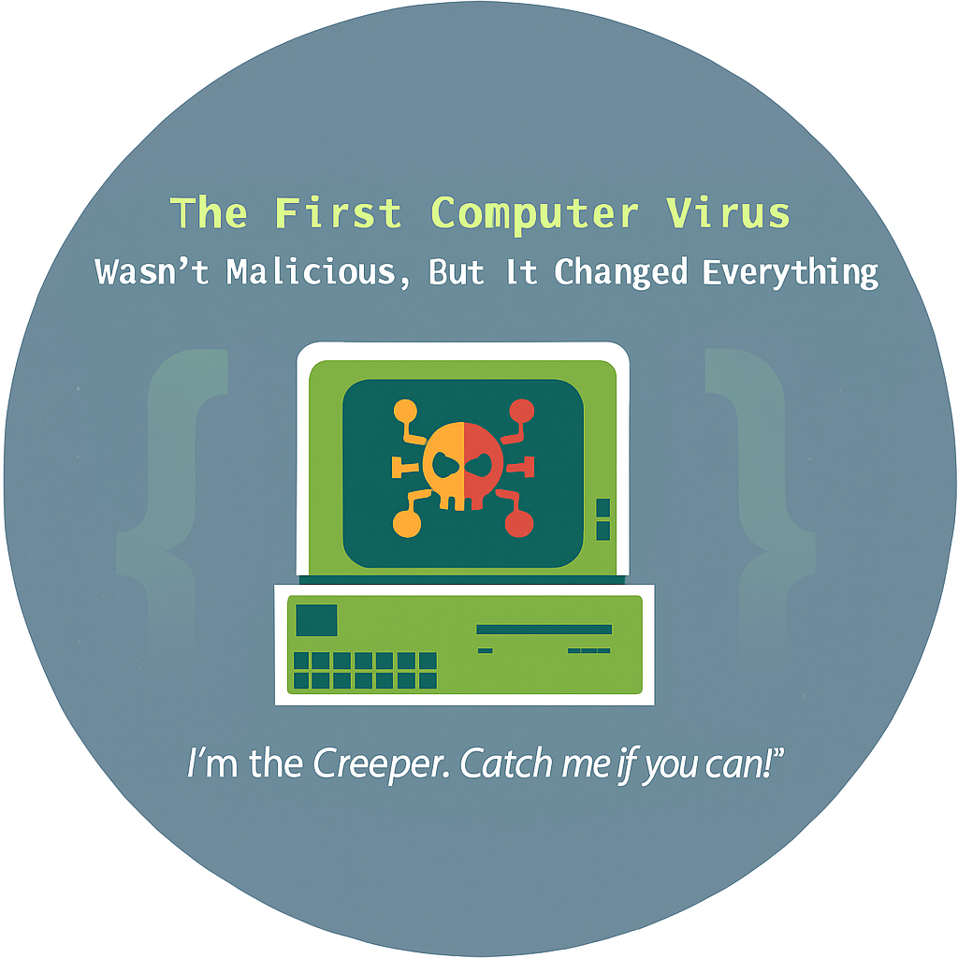
What is Malware?
"Malware" is a short term for "malicious software," and it refers to any software specifically designed to harm, exploit, or compromise computer systems, devices, or data without the user's consent. Malware includes various types of malicious programs such as viruses, worms, Trojans, spyware, adware, and ransomware, among others. Its primary intent is to infiltrate, disrupt, or steal information from a computer or network, and it can cause significant damage to both individuals and organizations.
800 × 534
The first malware, known as the "Creeper" virus, was created by Bob Thomas in the early 1970s. However, it wasn't as harmful as modern malware and was more of an experiment. Malicious software as we know it today evolved later.

Slide 3
Malware
Malware programmers develop and use malwares to
Attack browsers and track websites visited
Slow down systems and degrade system performance
Cause hardware failure, rendering computers inoperable
Steal personal information, including contacts
Erase valuable information, resulting in substantial data loss
Attack additional computer systems directly from a compromised system
Spam inboxes with advertising emails

Slide 4
Example of a simple malware code
@echo off
:A
Start Notepad
goto A
Note: This very simple batch program will continually open Notepad until you restart the system.

Slide 5
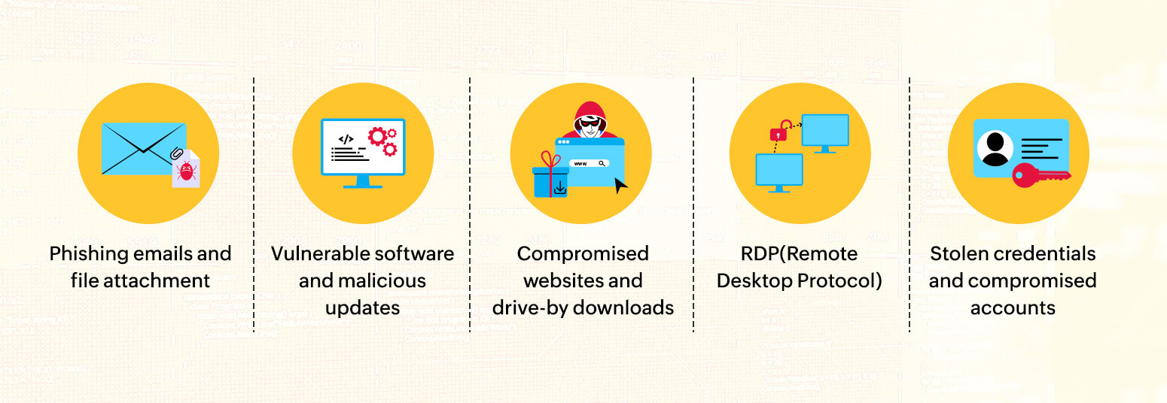
Different ways malware can enter your network

Slide 6
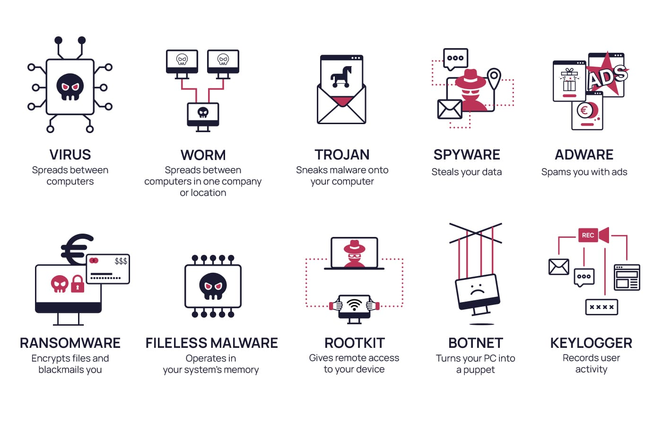
Types of Malware

Slide 7
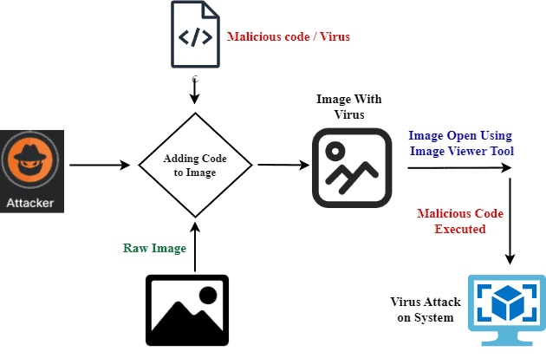
Viruses
A computer virus is a malicious program that infects files or the system areas of a computer and then makes copies of itself.
Viruses are harmful and can corrupt data and files; however, some viruses are harmless, too.
Computer viruses need a host to replicate. When you run or open an infected file or program, the virus attaches itself to other files, spreading its code and potentially causing harm.

Slide 8
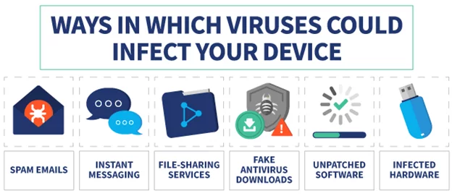
Viruses
Computer viruses spread through various means, including email attachments, infected software downloads, infected USB drives, or even network vulnerabilities.

Slide 9
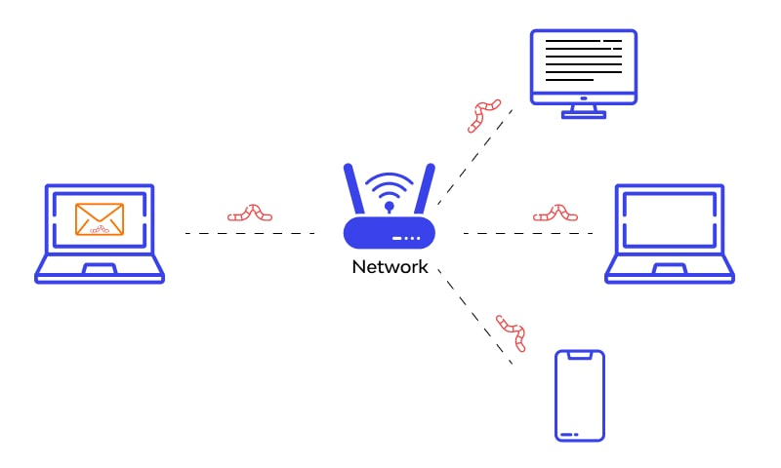
Worms
Worms are similar to viruses but can spread independently without user interaction or a host program/system. They exploit vulnerabilities in networked systems to propagate to other connected devices quickly.
For example, if one computer in an office is infected, the worm can move to other connected devices without anyone clicking anything, slowing systems and causing damage.

Slide 10
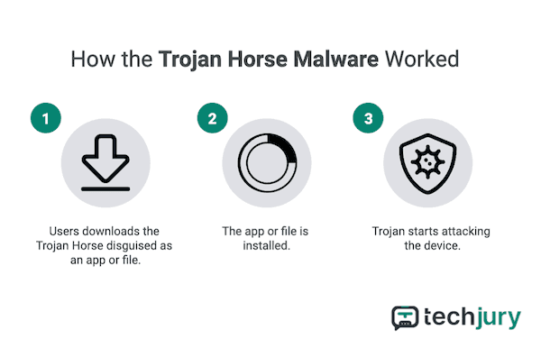
Trojans
Trojans disguise themselves as legitimate software but contain malicious code. They trick users into running them, which can result in data theft, system compromise, or other harmful actions.
Trojan malware gets its name from the stories ancient Greek poets told of Athenian warriors hiding inside a giant wooden horse, then emerging after Trojans pulled it within the walls of their city.

Slide 11
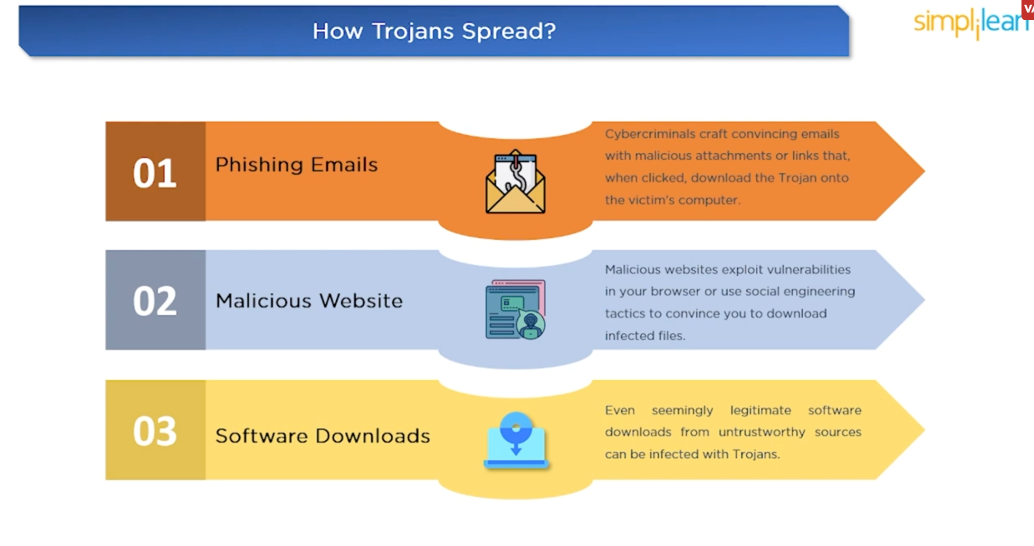
Trojans

Slide 12
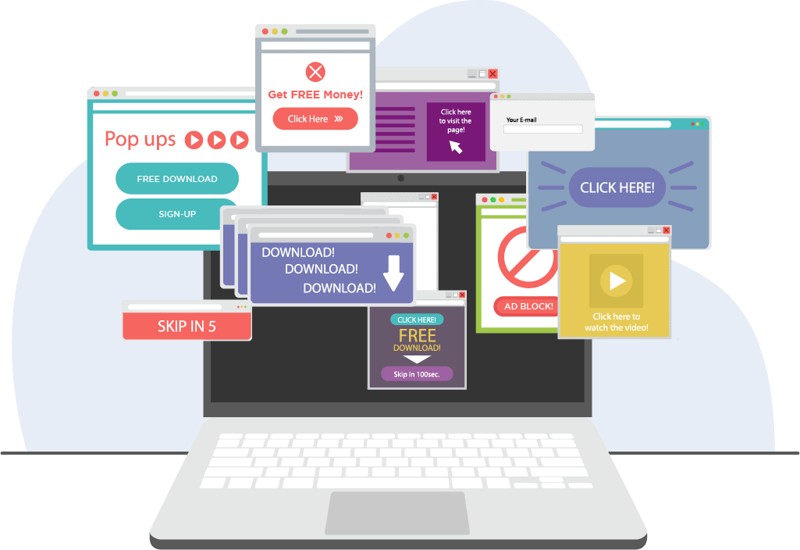
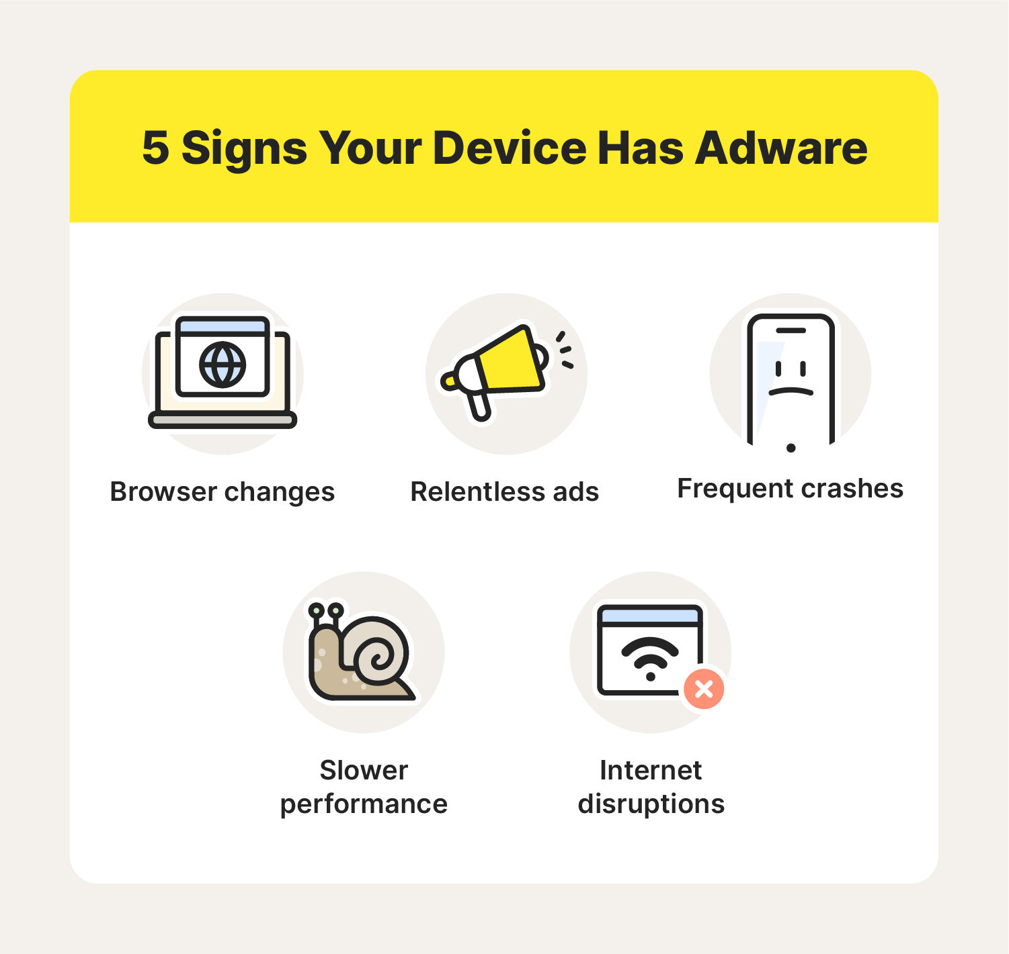
Adware
Adware displays unwanted advertisements to generate revenue for its creators. While it may not be as malicious as other types, it can be annoying and invasive.

Slide 13
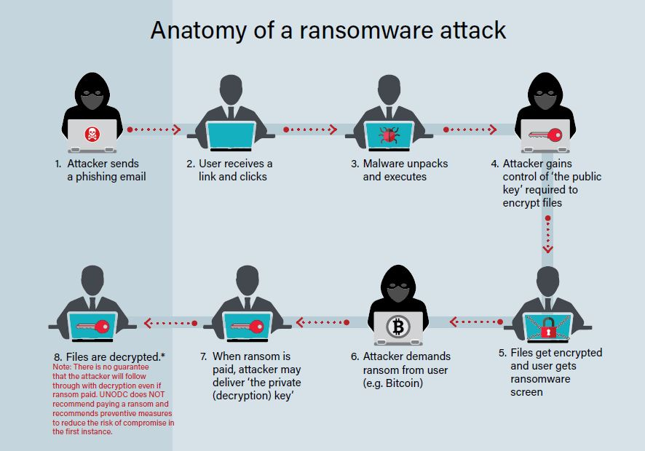
Ransomware
Ransomware encrypts a victim's files and demands a ransom for the decryption key. It can render data inaccessible until a ransom is paid, though paying is not recommended.

Slide 14

Spyware
Spyware collects information from an infected system without the user's knowledge or consent. It can capture sensitive data like passwords, credit card details, and browsing habits.

Slide 15
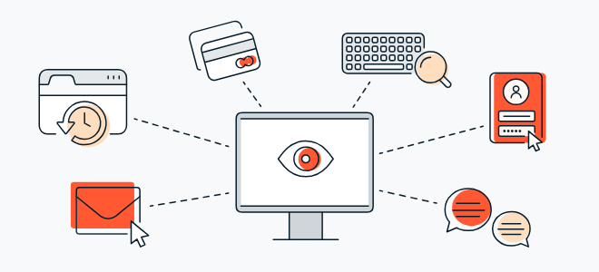
Keyloggers
Keyloggers record keystrokes on a computer, allowing attackers to capture sensitive information such as login credentials or credit card numbers.
Keyloggers can be both hardware-based and software-based, depending on the application.

Slide 16
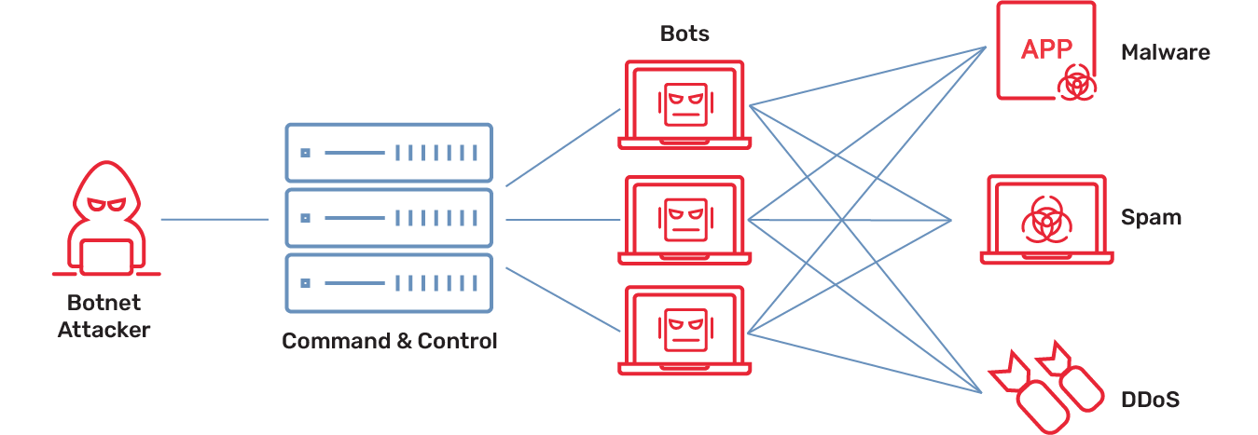
Botnets
A botnet is a network of compromised computers controlled by a central server. Cybercriminals use botnets to carry out various malicious activities, including distributed denial-of-service (DDoS) attacks. An attacker can seek out vulnerable devices and take control of those devices to build a botnet.

Slide 17
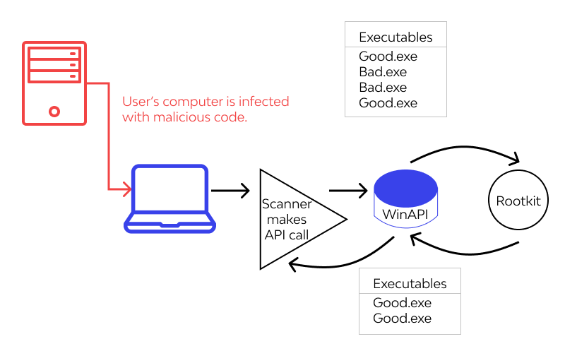
Rootkits
Rootkits are designed to hide malware and malicious activities from detection by security software and administrators. They often gain deep access to the operating system. Rootkits are difficult to find once they infect a system.

Slide 18
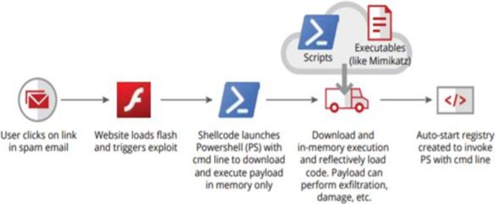
Fileless Malware
This type of malware operates in memory, leaving no trace on the disk, which makes it difficult to detect. It often relies on legitimate system tools to carry out malicious actions.

Slide 19
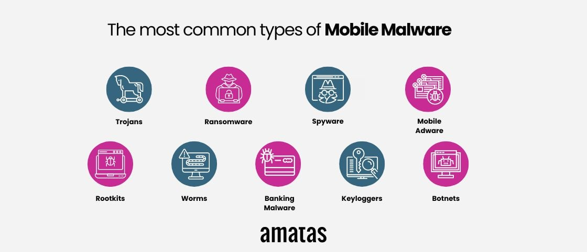
Mobile Malware
Malware targeting mobile devices, such as smartphones and tablets, can include viruses, Trojans, and spyware designed to compromise mobile operating systems.

Slide 20
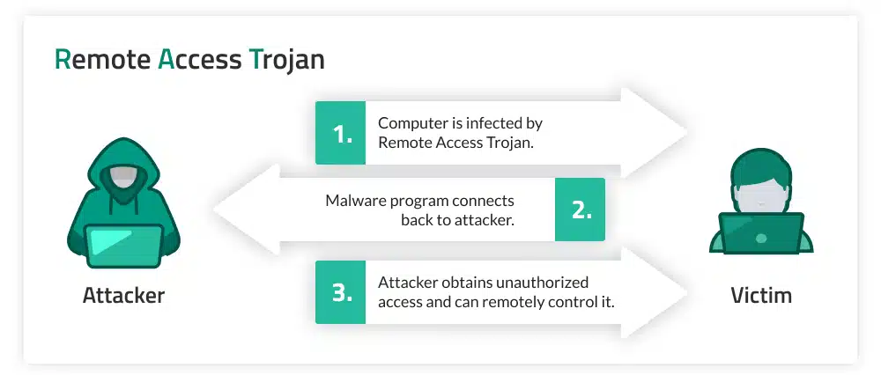
Remote Access Trojans (RATs)
RATs allow attackers to remotely control a victim's computer, often for unauthorized access, data theft, or surveillance.

Slide 21
Malware Components
1. Loader: The loader is responsible for initiating the malware's execution. It often serves as the initial entry point, and its primary task is to load and run the malicious code.
2. Payload: The payload is the core malicious code of the malware. It carries out the specific tasks that the malware is designed for, such as stealing data, spreading to other systems, or causing damage. The payload can be encrypted or obfuscated to avoid detection.
3. Command and Control (C2) Server Communication: Many malware strains communicate with a remote command and control server controlled by the attacker. This communication allows the malware to receive instructions, upload stolen data, or download updates. It's a crucial component for remote control and data exfiltration.

Slide 22
Malware Components
4. Persistence Mechanism: To maintain a presence on the infected system, malware often employs a persistence mechanism. This could involve modifying the Windows Registry, creating startup entries, or dropping hidden files that ensure the malware is executed each time the system restarts.
5. Evasion Techniques: Malware may include evasion techniques to avoid detection by security software. This could involve polymorphic code (changing its appearance with each infection), rootkit functionality (hiding its presence), or anti-analysis measures (detecting and evading analysis tools).
6. Data Exfiltration Module: If the malware's goal is to steal data, it will often include a component to exfiltrate the stolen information. This can involve compressing, encrypting, and transmitting data to a remote server controlled by the attacker.

Slide 23
Malware Analysis
Malware analysis is the process of determining the detailed functionality, purpose, and impact of an identified malware. This can be done as a part of malware research, incident management, or identifying indications of compromise for any software.
In general, malware analysis can be categorized into two types:
Static Analysis: Dissecting different components of the malware, such as memory dumps, disassembled binaries, hashes, strings, etc to find out the nature of the malware, without running the program.
Dynamic Analysis: Observe and analyze the behavior of the malware after running it in a sandboxed environment. The malware is run in a virtual machine where a security expert observes its runtime activities to gather more information.

Slide 24
Thank You

